Slide 1

UniFind
Group members:
Jiwoo Lee
Cynthia Liu
Jennie Li
Zoe Ning
Jeehyun Yoon

Slide 2


Abstract
University application process = highly inefficient and time consuming
UniFind → More efficient and manageable system by providing algorithmic solutions in sorting Universities by categories
Ex. ranking, program size, location, acceptance rate
Using related datasets

Slide 3
Objective
Canadian universities info-searching.
A more comprehensive understanding on universities.
Search keywords in the app to retrieve related information about it.
The target audience for this project will be highschool students.
Address their need of accessing information about universities.

Slide 4
Motivation
So much information to draw conclusion
Concluding result
Memory bias -> detailed & clear fact
List of university according to different categories sorting
Inner look to universities

Slide 5
Prior Work
Comparison Product: OUAC website
Similarities:
Help apply to an Ontario University
Provide detailed introduction and application guide of all universities available
Advantages of Our Product:
Use multiple CSV format datasets
Search for info with names of Universities
Find proper universities that satisfy users conditions
Be targeted and relevant to all users

Slide 6

Input / Output & Proposed Solutions
Ranking, target enrollment, admission average
3 years employment outlook
Canadian/international tuition
Undergraduate application statistics
Revenues/expenditures of universities
Employment income group based on fields
Our main goal would be sorting/searching based on input keywords from users
Ex. Input: Computer Science, Top 10
Output: Sorted list of top 10 computer science programs in Canada

Slide 7
Algorithmic Challenges
Sort algorithms:
Quick sort: Deal with large data
Insertion sort: Slower than other method, however, It shows better efficiency at the small data set.
Search algorithm:
Linear search: When the size of the total data set is not larger than 1000, the linear search algorithm is much faster than the other one.

Slide 8
Algorithmic Challenges
Other challenges:
Accuracy and fastness: There will be over 1000 data in the application. The app should provide the exact information to users in a very short time.
Collision: The collisions between methods or algorithms could have happened. If this problem occurs while the customer is using the app, it causes inconvenience and loss of the application's reputation. Therefore, reducing collision is the biggest challenge.

Slide 9
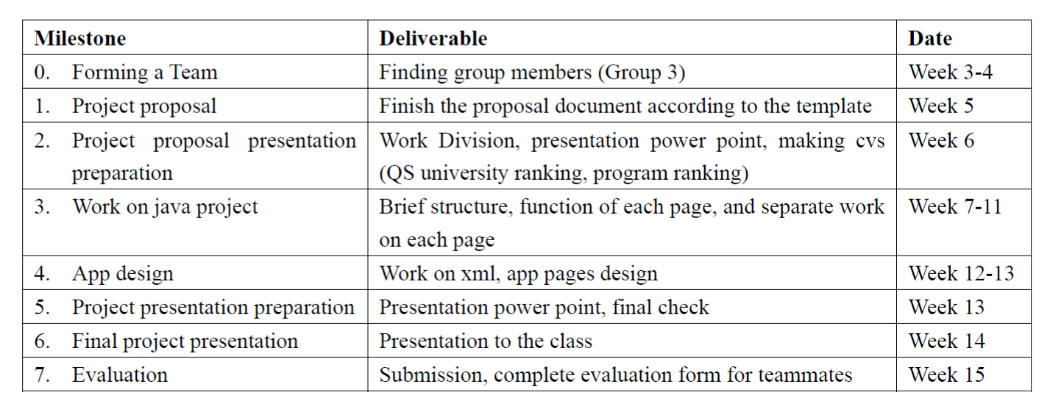
Project Plans

Slide 10



References
Government of Canada Open Dataset
Ontario Universities’ Application Centre (OUAC)
QS World University Rankings

